Slide 1

IoT-enabled Classroom with Android Application
Department of Computer Science & Engineering – Internet of Things
(Supervisor: Dr. Santosh Kumar)
Group Members
Name of Member | Roll Number | Role
Shiv Shikhar Sinha | 2001331550033 | Circuit Design & Code (Android App, Arduino Code and Firebase Configuration)
Varun Kumar | 2001331550038 | Research Paper, Synopsis and Project Report
Ritik Kumar Yadav | 2001331550030 | Hardware Design and Assembly

Slide 2

Index
Introduction
Literature Survey
Problem Statement
Proposed Methodology (Including DFD/ER Diagrams/ Use Cases)
Hardware / Software Requirements
Live Project Progress
Research Paper Status
Future Action Plan

Slide 3
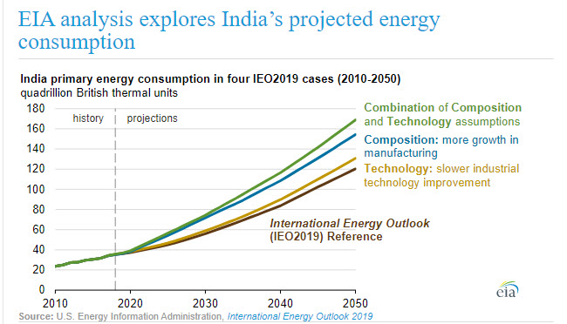
Introduction
In today’s era, energy efficient devices are the need of the time. We humans are wasting too much electricity by not turning of the lights and fans in our class.
People don’t even pay attention to unnecessary usage of electrical energy. So, we need a smart system to control the functioning of the lights and fans according to the requirement in the room. The system is based upon IoT.
Ref- US Energy Administration, International Energy Outlook 2019

Slide 4
Literature Survey
1. “Smart Energy Efficient Home Automation System using IOT”, by Satyendra K. Vishwakarma, Prashant Upadhyaya, Babita Kumari, Arun Kumar Mishra.
This paper presents a step-by-step procedure of a smart home automation controller. It uses IOT to convert home appliances to smart and intelligent devices, with the help of design control. An energy efficient system is designed that accesses the smart home remotely using IOT connectivity.

Slide 5
Literature Survey
2. “A Dynamic Distributed Energy Management Algorithm of Home Sensor Network for Home Automation System”, by Tui-Yi Yang, Chu-Sing Yang, Tien-Wen Sung.
This paper proposes an optimization of home power consumption based on PLC (Power Line Communication) for an easy to access home energy consumption. This also proposes a Zigbee, and PLC based renewable energy gateway to monitor the energy generation of renewable energies.

Slide 6
Literature Survey
3. “Enhance Smart Home Automation System based on Internet of Things”, by Tushar Chaurasia and Prashant Kumar Jain.
This paper proposes a system that develops a model to reduce the computation overhead in existing smart home solutions that uses various encryption technologies like AES, ECHD, hybrid, etc. these solutions use intermediate gateway for connecting various sensor devices.

Slide 7
Problem Statement
Design of an independent IoT Enabled Classroom Automation System
To formulate the design of an interconnected network of home appliance to be integrated into the Automation System. The objective is to account for every appliance and its control to be automated and integrated into the network further formulated into the system automating based on the number of people.
Wireless control of appliances using an Android Application.
To control and monitor the status of devices and appliances using the Android Application.
Monitoring the progress of students to enhance learning experience and interactivity.
Being able to monitor students’ progress with the help of IoT and ensuring privacy and security of data.

Slide 8
Problem Statement
Controlled by any device capable of Wi-Fi (Android, iOS, PC)
To achieve flexibility in control of the appliances, and device capable of Wi-Fi connectivity will be able to obtain a secure control on the Automation System.
Extensible platform for future enhancement
With a strong existing possibility of adding and integrating more features and appliances to the system, the designed system needs to be highly extensible in nature.

Slide 9
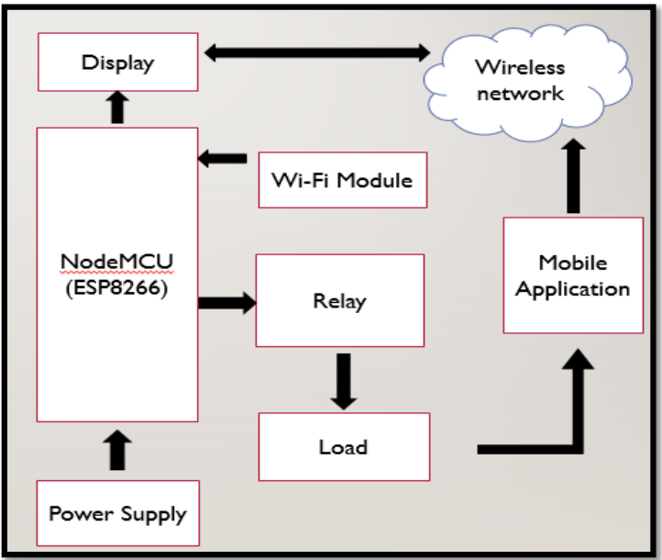
Proposed Methodology
Block Diagram of the Proposed System
The block diagram gives the functionality of the overall project which involves several modules and devices.

Slide 10
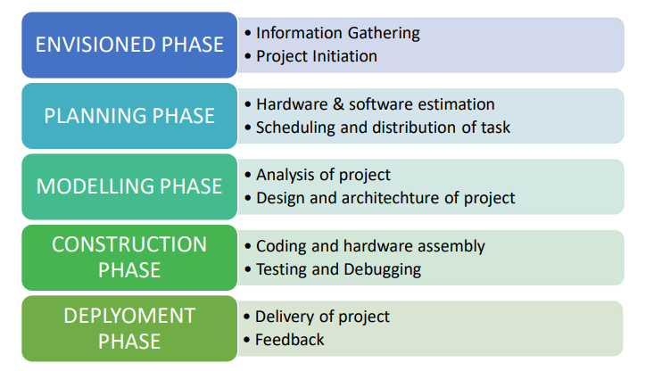
Proposed Methodology

Slide 11
Proposed Methodology
Existing devices like fans, lights etc.
Other Sensors
To Build an innovative solution that automates various aspects of a classroom, including devices such as fans, lights, and projectors, while also monitoring student performance and promoting sustainability by saving electricity.
The system includes an IoT device consisting of various sensors and microcontrollers ( like NodeMCU ) connected to existing devices in the classroom and an Android App that provides control and monitoring of automation to administrators, including teachers and class representatives. The system is accessible with an internet connection and can be controlled and monitored from anywhere in the world.
DHT11
NodeMCU
Google Firebase
Android Application

Slide 12
Hardware/ Software Requirements
Node MCU is one of the microcontroller unit in the prototype. It has an in-built Wi-Fi module (ESP8266) that establishes wireless remote switching of appliances and devices.
LED and resistors are used in this prototype to replace real appliances. They indicate power being turned on and off to the appliances. In real time operation they would be replaced by actual home appliances.
DHT11 is a Temperature and Humidity Sensor used to collect data of temperature and humidity from the surrounding and send to the application through microcontroller.
Google Firebase is a set of backend cloud computing services and application development platforms provided by Google, used here to be the mediator between the microcontroller and the android application enabling them to communicate with each other
Android Application is a custom app designed and developed for this IoT enabled Classroom Automation System in Java language and ought to be used by admins to control and monitor various functionalities.
Android Studio and Arduino IDE are the software that are used to develop the Android Application and Deploy the Arduino Sketch (Code) to the NodeMCU for this project.

Slide 13
Hardware/ Software Requirements
NodeMCU (ESP8266)
DHT11 (Temperature & Humidity) Sensor
LEDs
Bread Board
Jumper Wires
USB Cable
Android Studio
Google Firebase
Arduino IDE

Slide 14
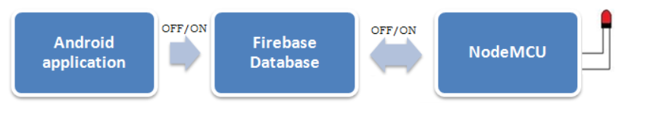
Model Working
Working principle of the project (Android app, Google Firebase, and Node MCU)
In this project, there are three main components are used an Android app, Firebase database and, Wi-Fi Node MCU with Arduino.
The Android app sends the serial data 1 or 0 to the Firebase database. The Firebase database interacts with Wi-Fi NodeMCU and this NodeMCU acts on the basis of data received from Firebase Database. If NodeMCU receives serial data 1, it turns ON the LED, and if NodeMCU receives serial input 0 then it turns OFF the LED.

Slide 15
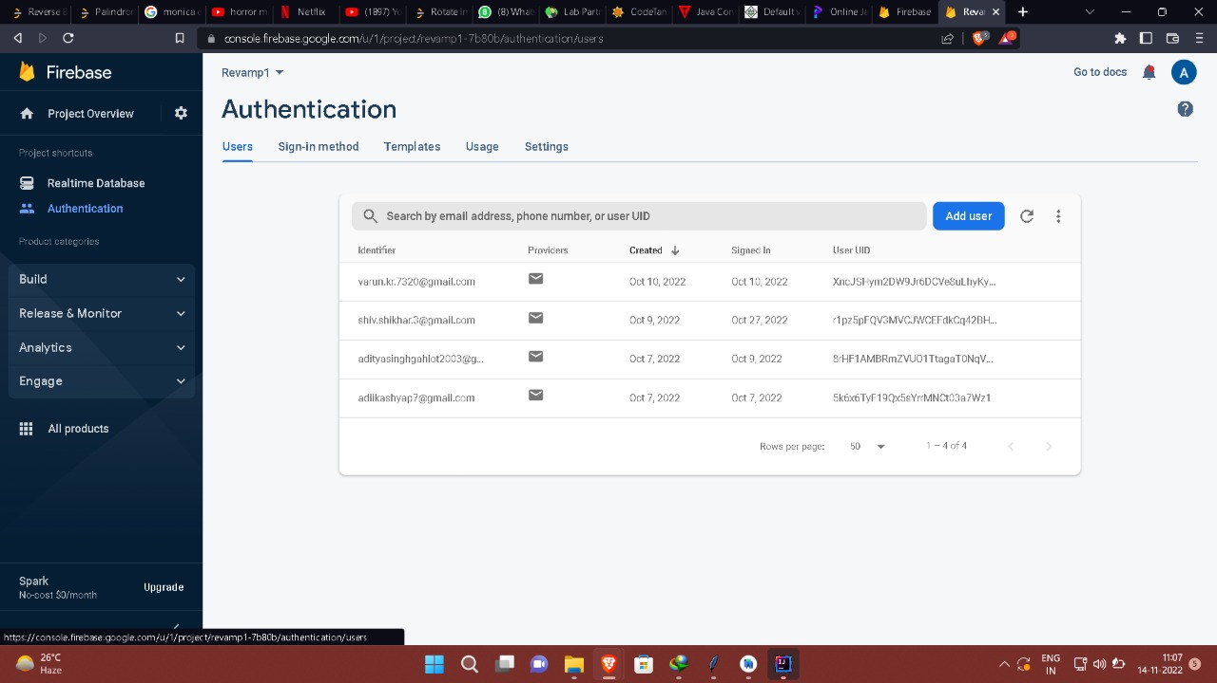
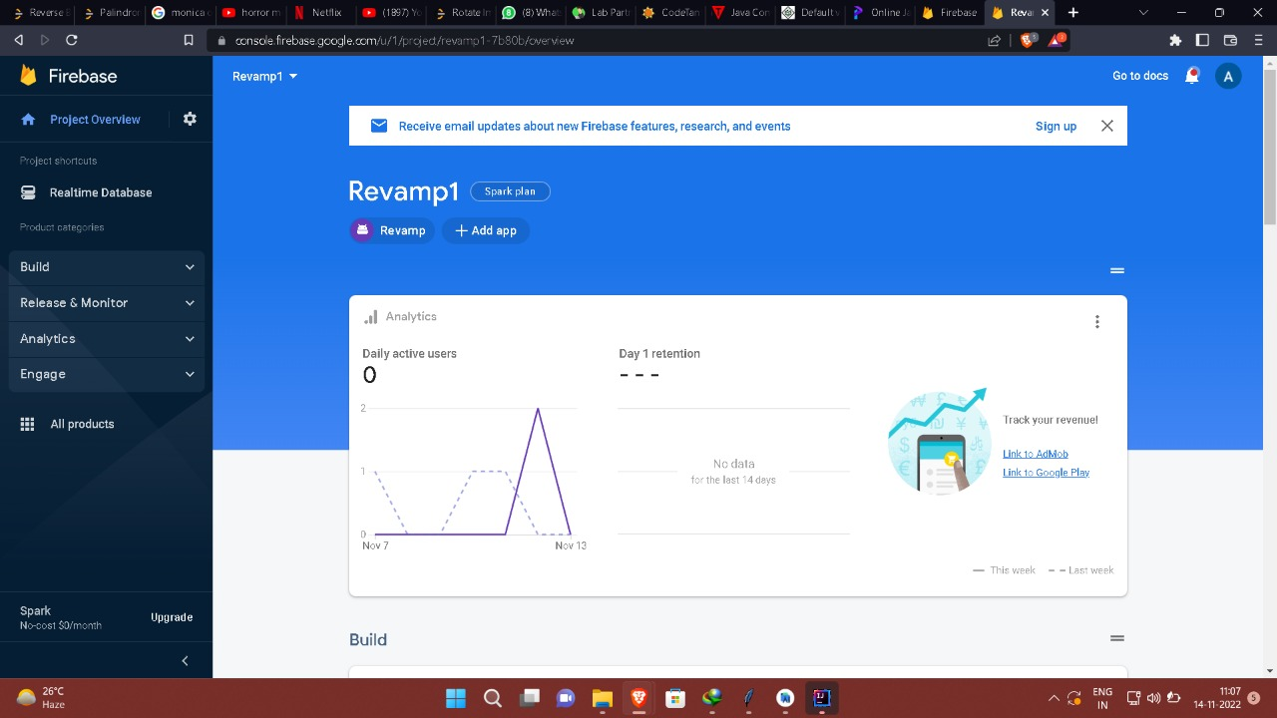
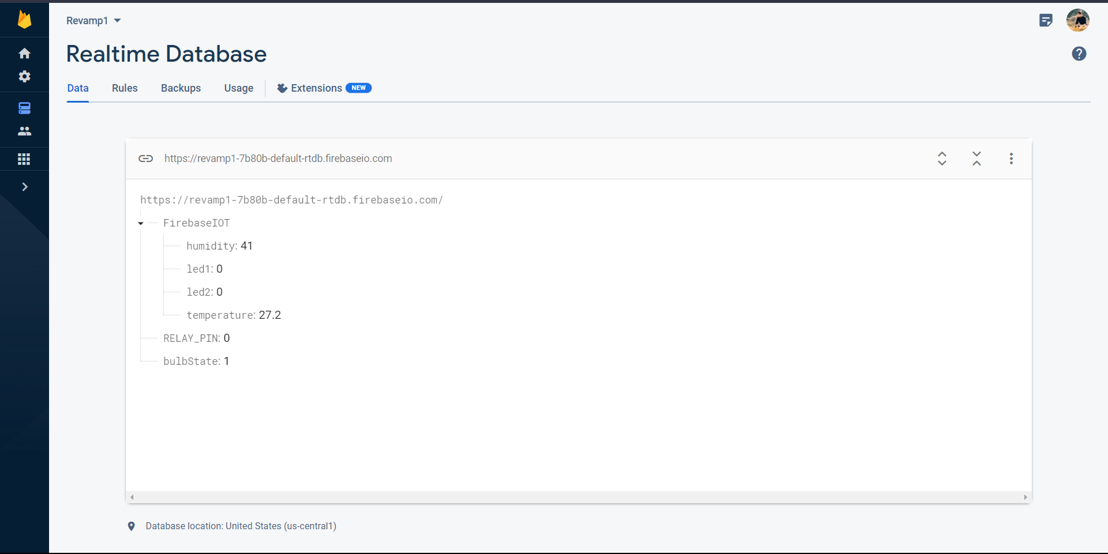
Google Firebase – Realtime Database

Slide 16
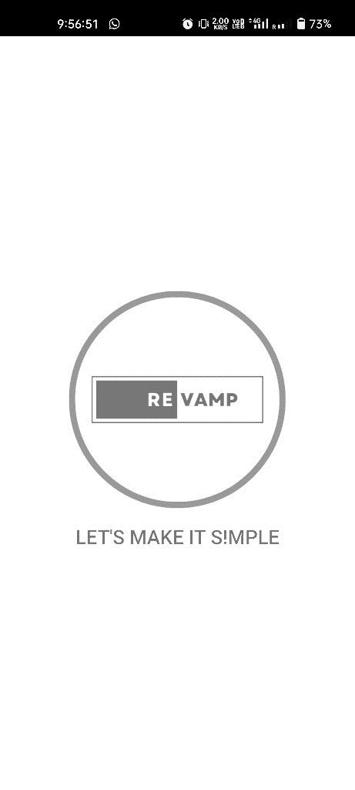
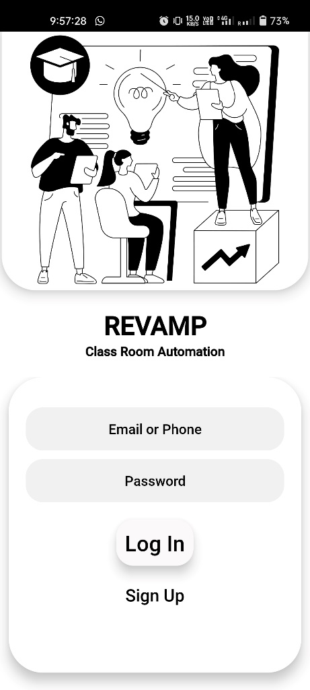
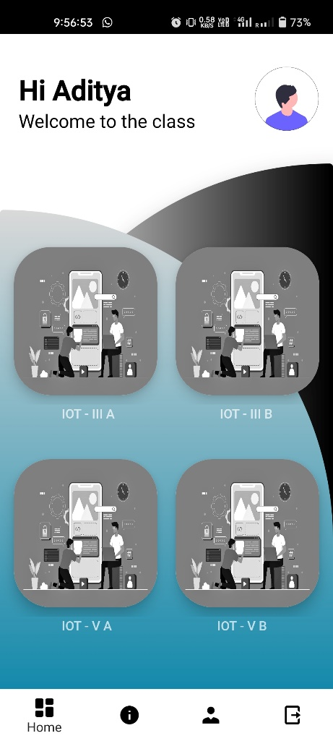
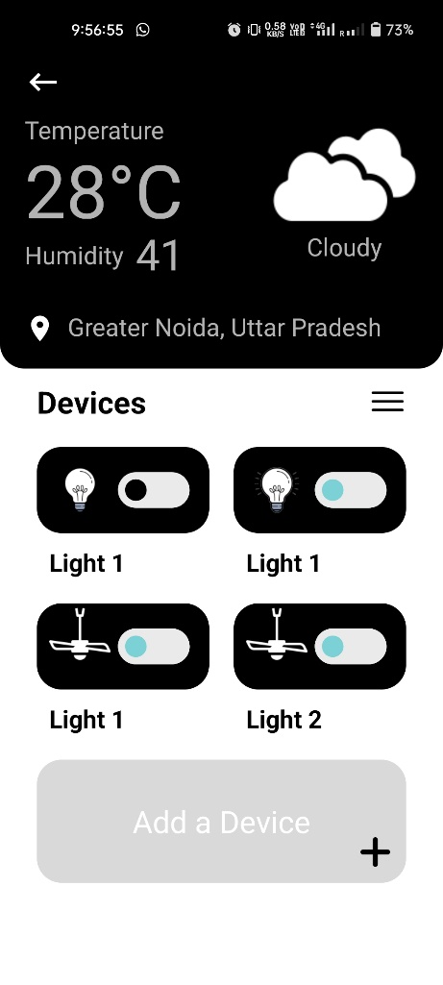
Live Project Progress - APP

Slide 17
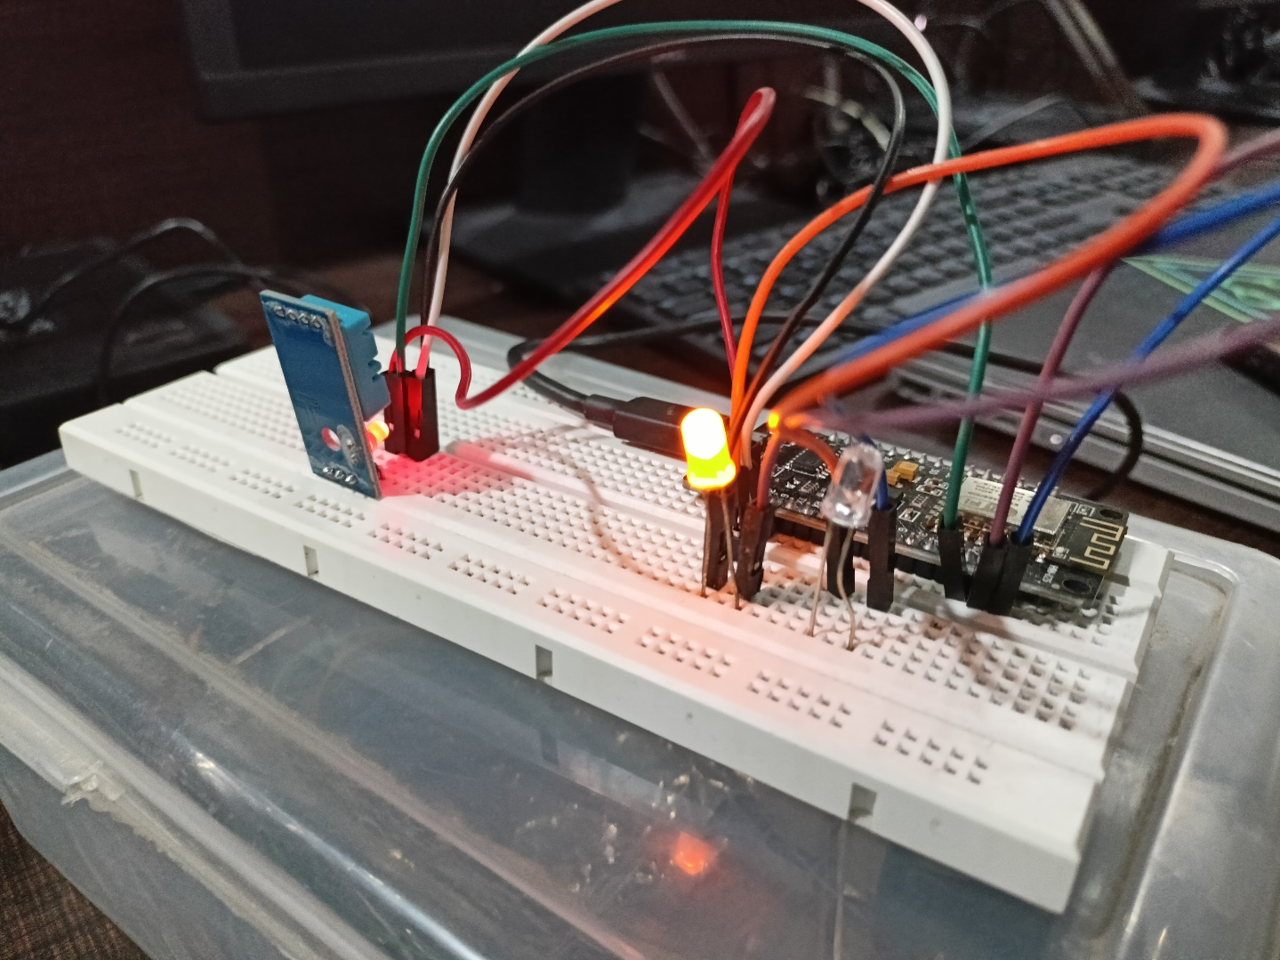
Live Project Progress – IoT Device

Slide 18
Research Paper Status
Research Paper Completed | Contents of Research Paper-
Abstract
Keywords,
Introduction,
Literature Survey
Methodology
Hardware Requirements
Software Requirements
Block Diagram
Conclusion and Future Scopes
References.

Slide 19
Future Action Plan
We look forward to develop this prototype into a fully-functional working model and then we will implement this in a physical classroom so that we can experience the usability of Automated Environment.
It will be useful in automating tasks and appliances in a classroom environment and monitoring students’ performance.
This project also aims to save energy in the present and future scenarios.

Slide 20
Thank You

Slide 21
Feedback from the Panel
The panel wants the team to :
Make some changes in the presentation and present the prototype model to the panel.
Work satisfactory, Improvement in the app is advised.

